Slide 1
Can Claude Create Better Excel Templates for Instruction?
Presented by David Stephan
David@TwoBridgesIT.com
Tuesday, August 4, 2026, 2 PM Eastern
bit.ly/TBITDownloads

Slide 2
Working Title was
Can 15 Minutes with Claude Undo 26 Years of Paid Work?
Or, save you 15% or more on your auto insurance

Slide 3
Let’s Have Some FUN!
From examples
Understanding and
New insights
F
U
N

Slide 4
New Insights Goal
Give you something new to think about when using
AI tools in “DASI” courses.

Slide 5
Plan for Today
“I somewhat know about Claude, but what is it again?”
Excel templates
Can Claude do better than an instructional designer?
Larger issues raised by results Claude produces

Slide 6
A Little Bit About Claude

Slide 7
Claude, Defined by Claude
“Claude is an AI assistant made by Anthropic.
It's built on a large language model trained to understand and generate text (and now also work with images, code, and files).
It's designed to be helpful, honest, and safe in conversations.”

Slide 8
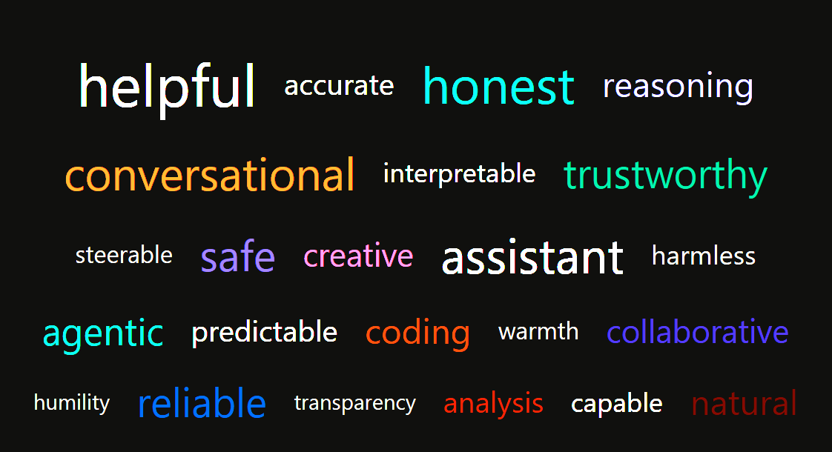
Description of Claude

Slide 9
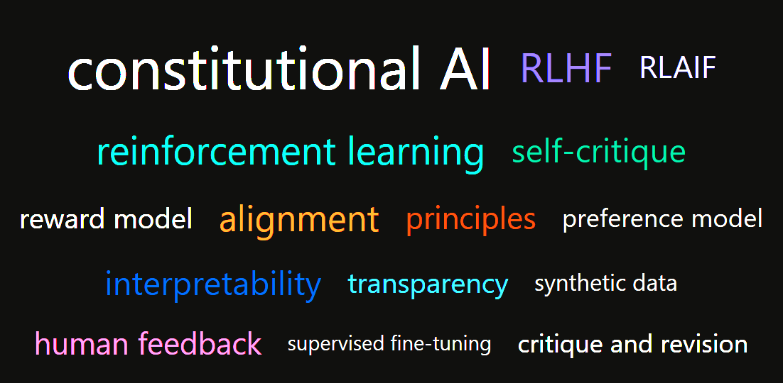
Technical Description of Claude

Slide 10
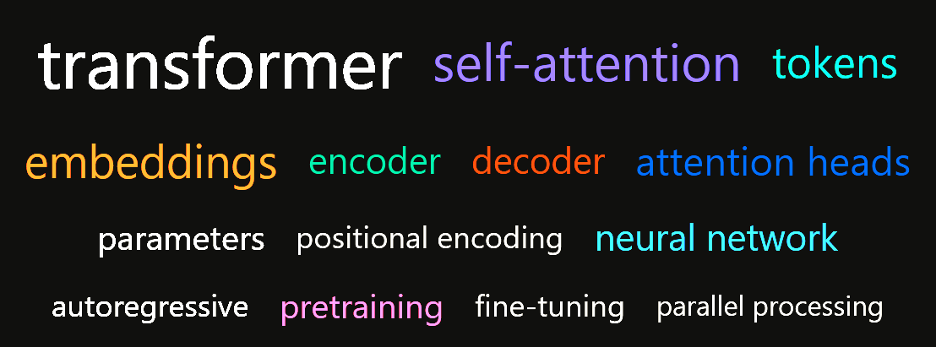
Compare to “Large Language Model”

Slide 11
Agent, Defined by Claude
Instead of "answer one question, done," an agent can use tools…look at the results, decide what to do next, and keep looping until the task is finished—with little or no hand-holding in between steps.”

Slide 12
“Claude reigns over the usual Gen AI suspects for the moment.”
Contains wordplays including Claude Rains.
Claude Who?

Slide 13
Comparison
Claude Rains | Claude.ai
Versatile character actor | Versatile agent
Worked from a script | Works from a script
Can be invisible | Can be invisible
Nominated for Best Supporting Actor Oscar four times | Can identify the movies for which Rains was nominated
Rounds up the usual suspects | Rounds up data

Slide 14
How is a Claude agent like a character actor?
“It's a fun analogy! Here's how a Claude agent is like a character actor:”
Both inhabit a role defined by someone else.
Both bring consistent traits to every scene.
Both have an underlying identity beneath the costume.
Both can play many different roles, but not just any role.
Both improvise within the spirit of the script.

Slide 15
Excel Templates

Slide 16
Templates: Business Reasons
Validation
Audit
Presentation

Slide 17
Templates: Instructional Reasons
Examples of best practices
Blueprints for model solutions
Illustrations of proper presentation
Opportunities for experimentation

Slide 18
For “DASI-Type” Courses, Templates
Enable learners to focus on subject matter.
Eliminate user interface distractions!
=SUM(… = SUM(… =SUM (…

Slide 19
Designer’s Special Concerns (circa 2000)
Learners’ unfamiliarity with Excel
Limits of display technology
Efficiency of (re)calculations

Slide 20
Instructional Designer’s Templates
Create a coherent set (60+)
Transform Analysis Toolpak worksheets into live worksheets
Add an AI* librarian-editor (PHStat) to further facilitate access to set of templates
*Authentically Interactive

Slide 21
Look at some examples
Normal probability
Hypothesis test
Multiple regression

Slide 22
Normal Probability Templates

Slide 23
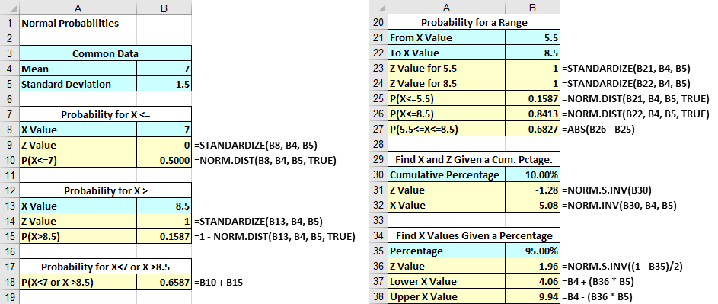
Instructional Designer

Slide 24
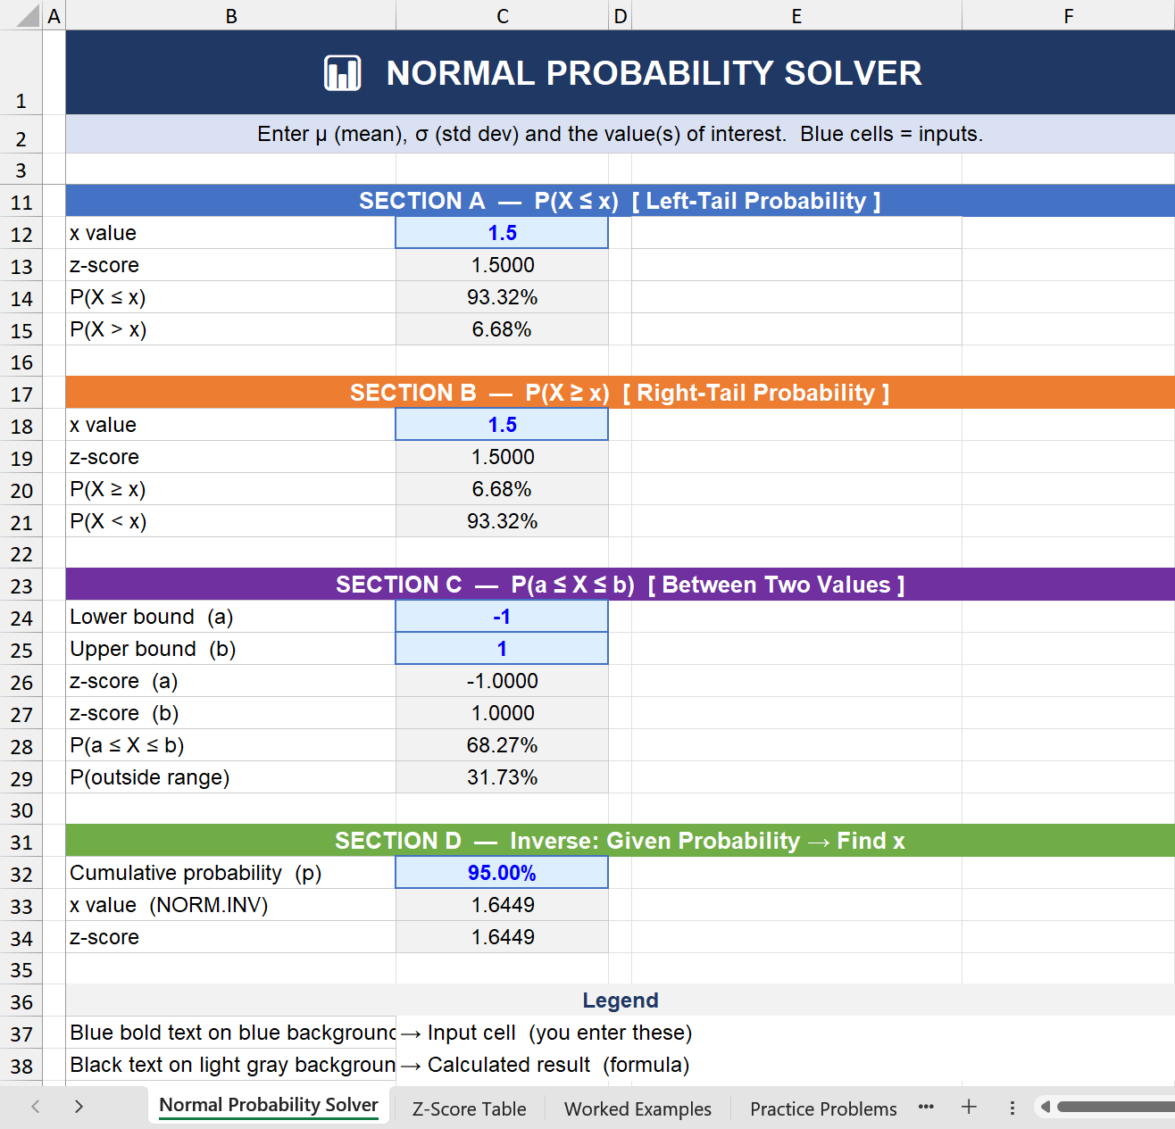
Claude

Slide 25
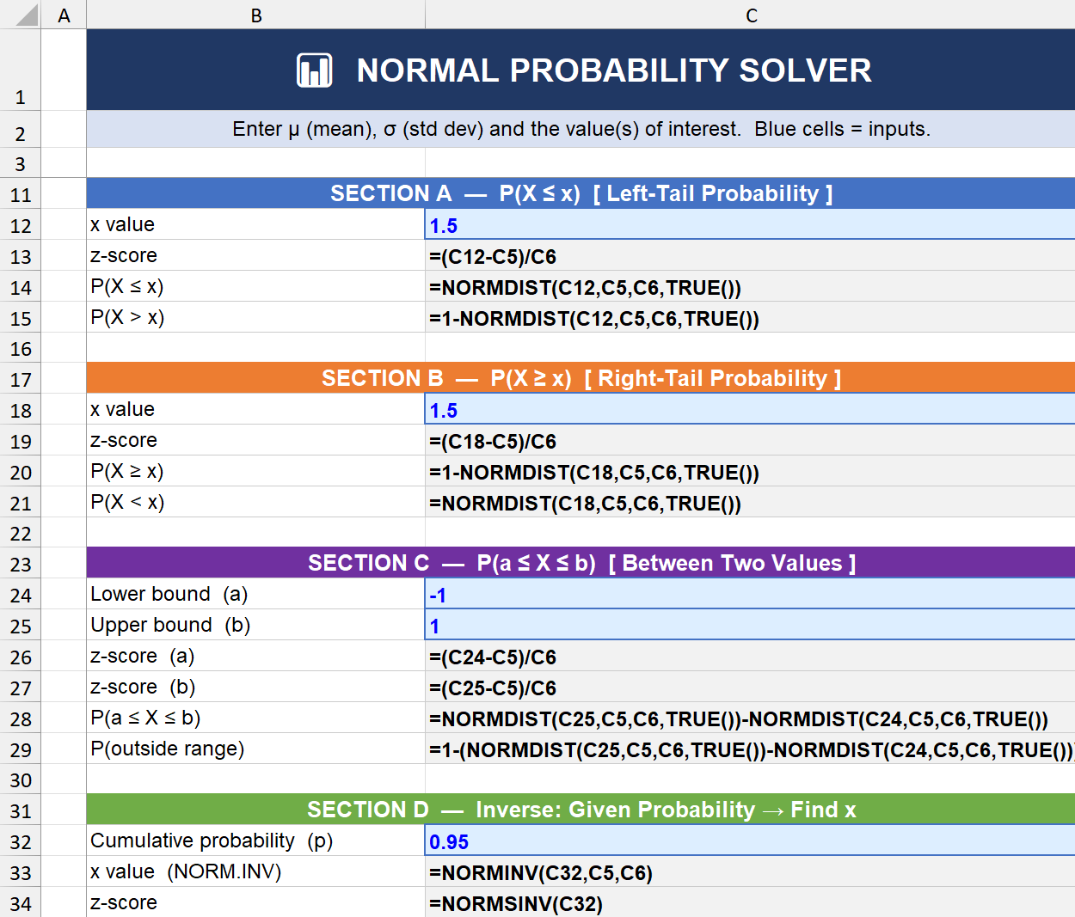
Claude

Slide 26
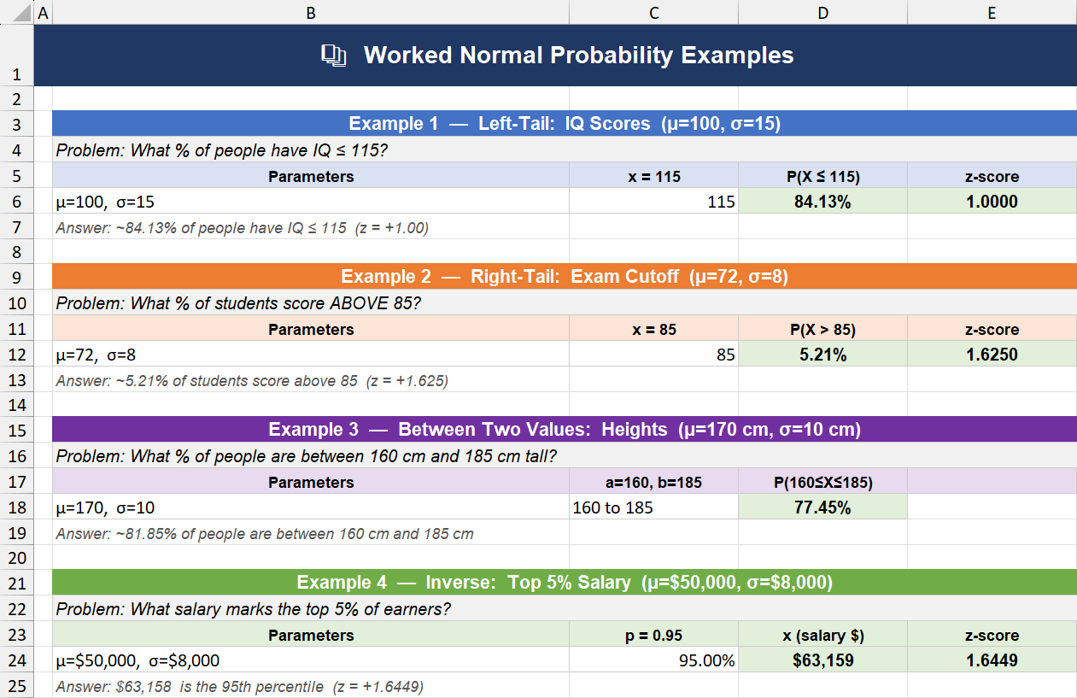
Claude

Slide 27
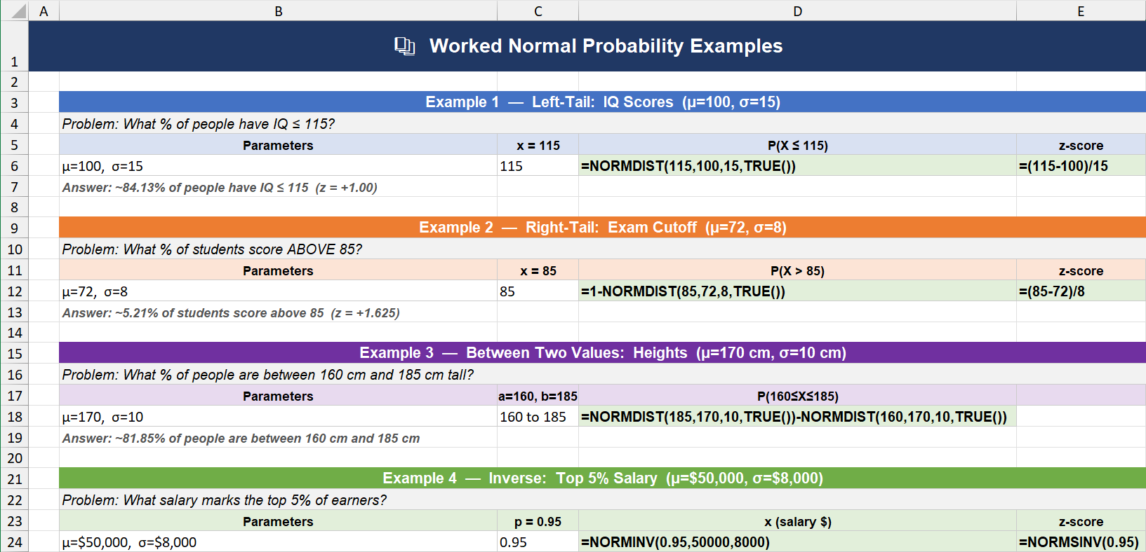
Claude

Slide 28
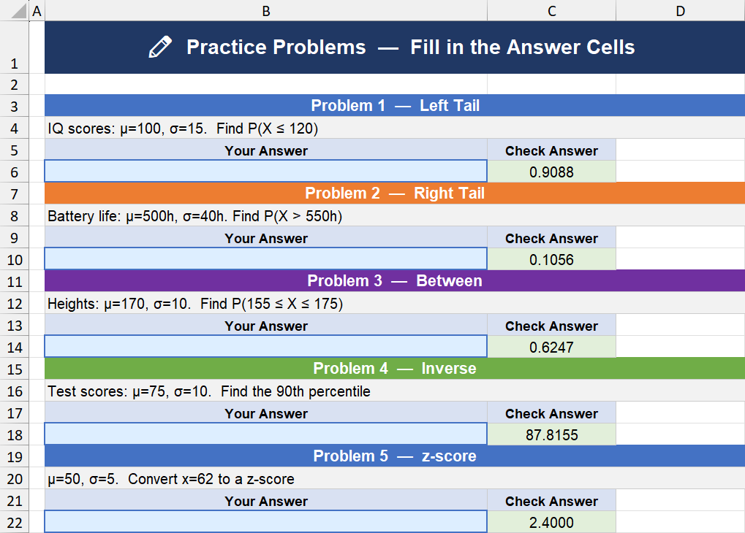
Claude

Slide 29
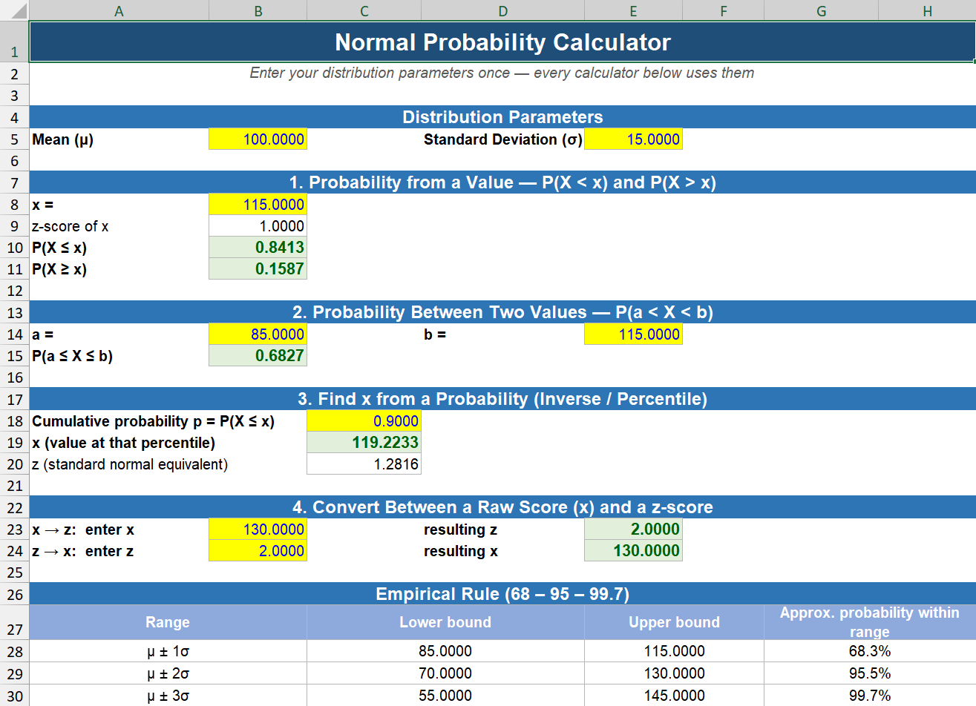
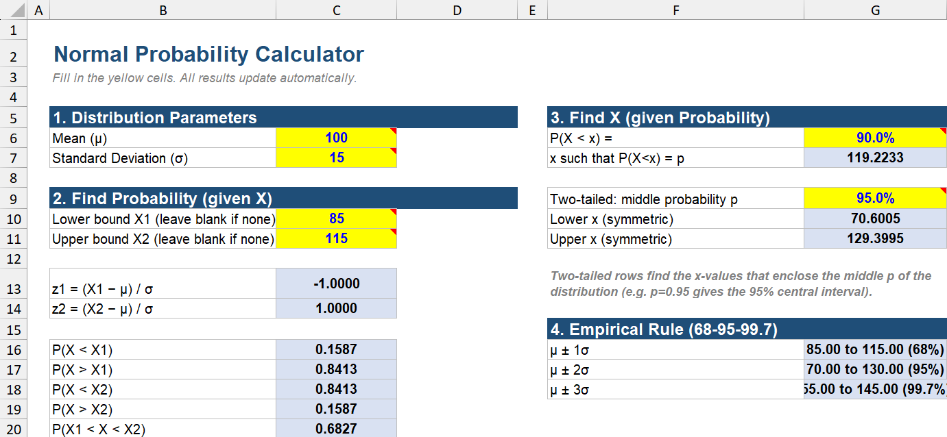
Overlooked: Time of Day,
Model Deployed,
Level of Service,
Affect Results

Slide 30
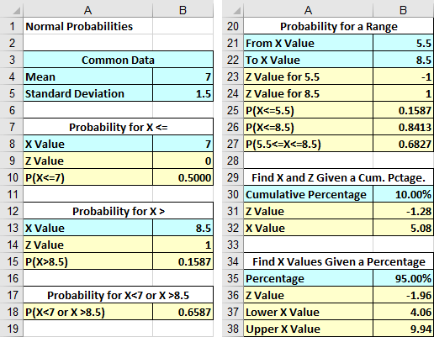
Always the Same!

Slide 31
Hypothesis Test Templates

Slide 32
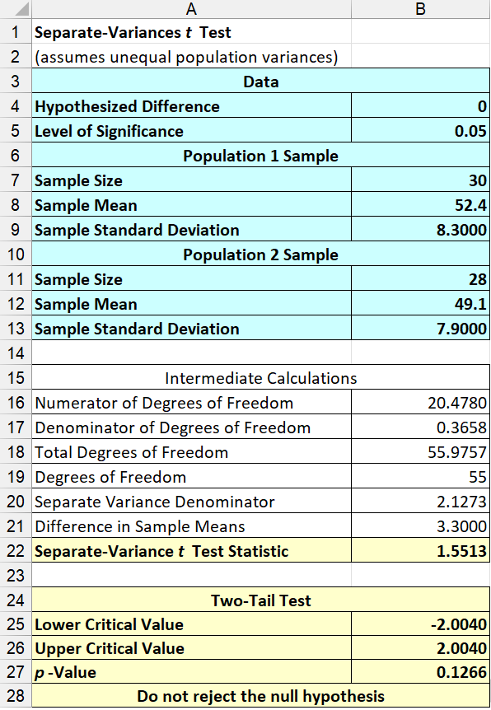
Instructional Designer

Slide 33
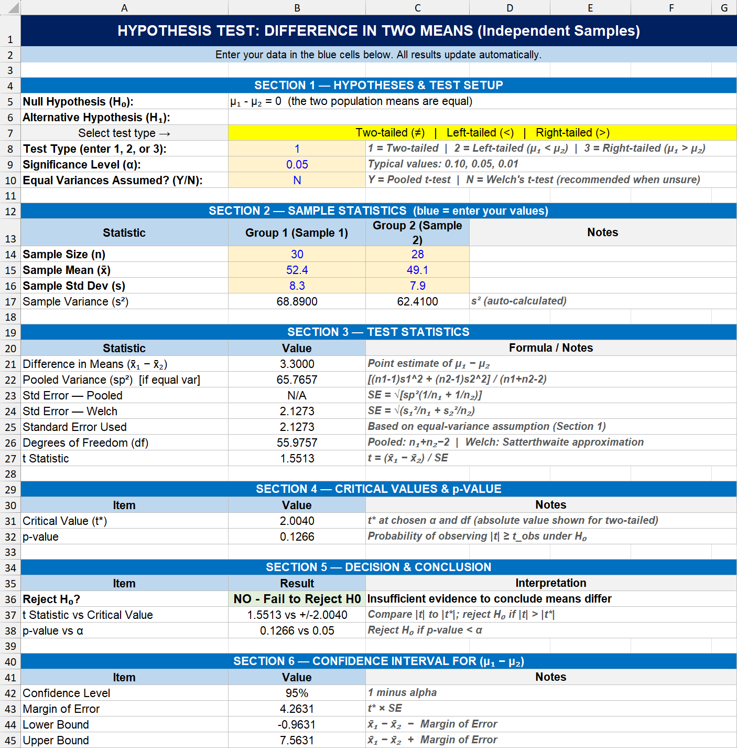
Claude

Slide 34
Multiple Regression Templates

Slide 35
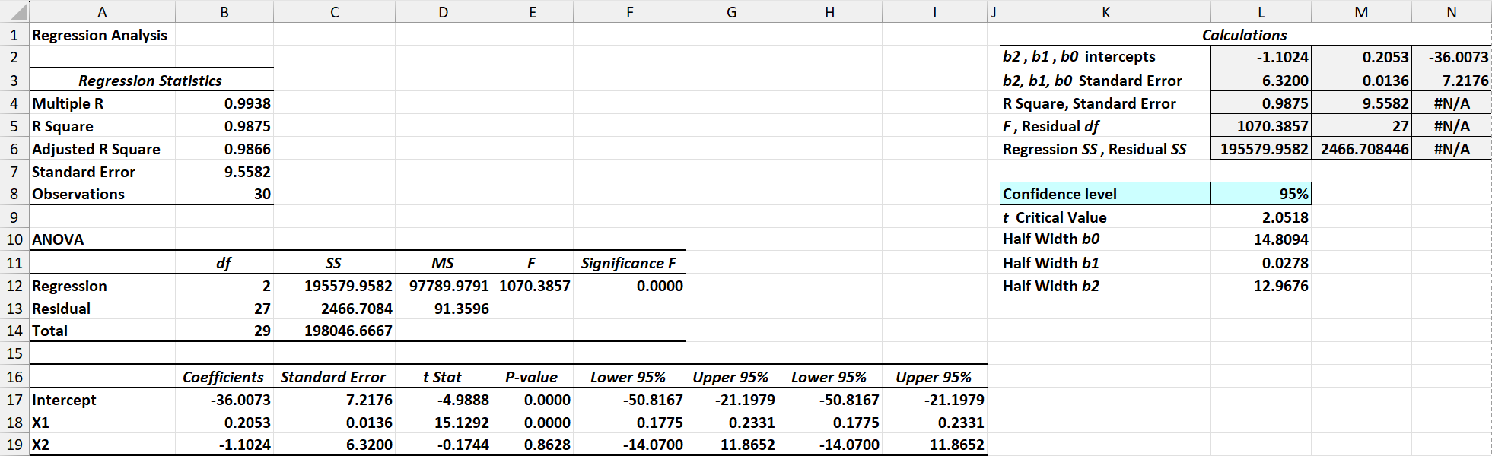
Instructional Designer

Slide 36
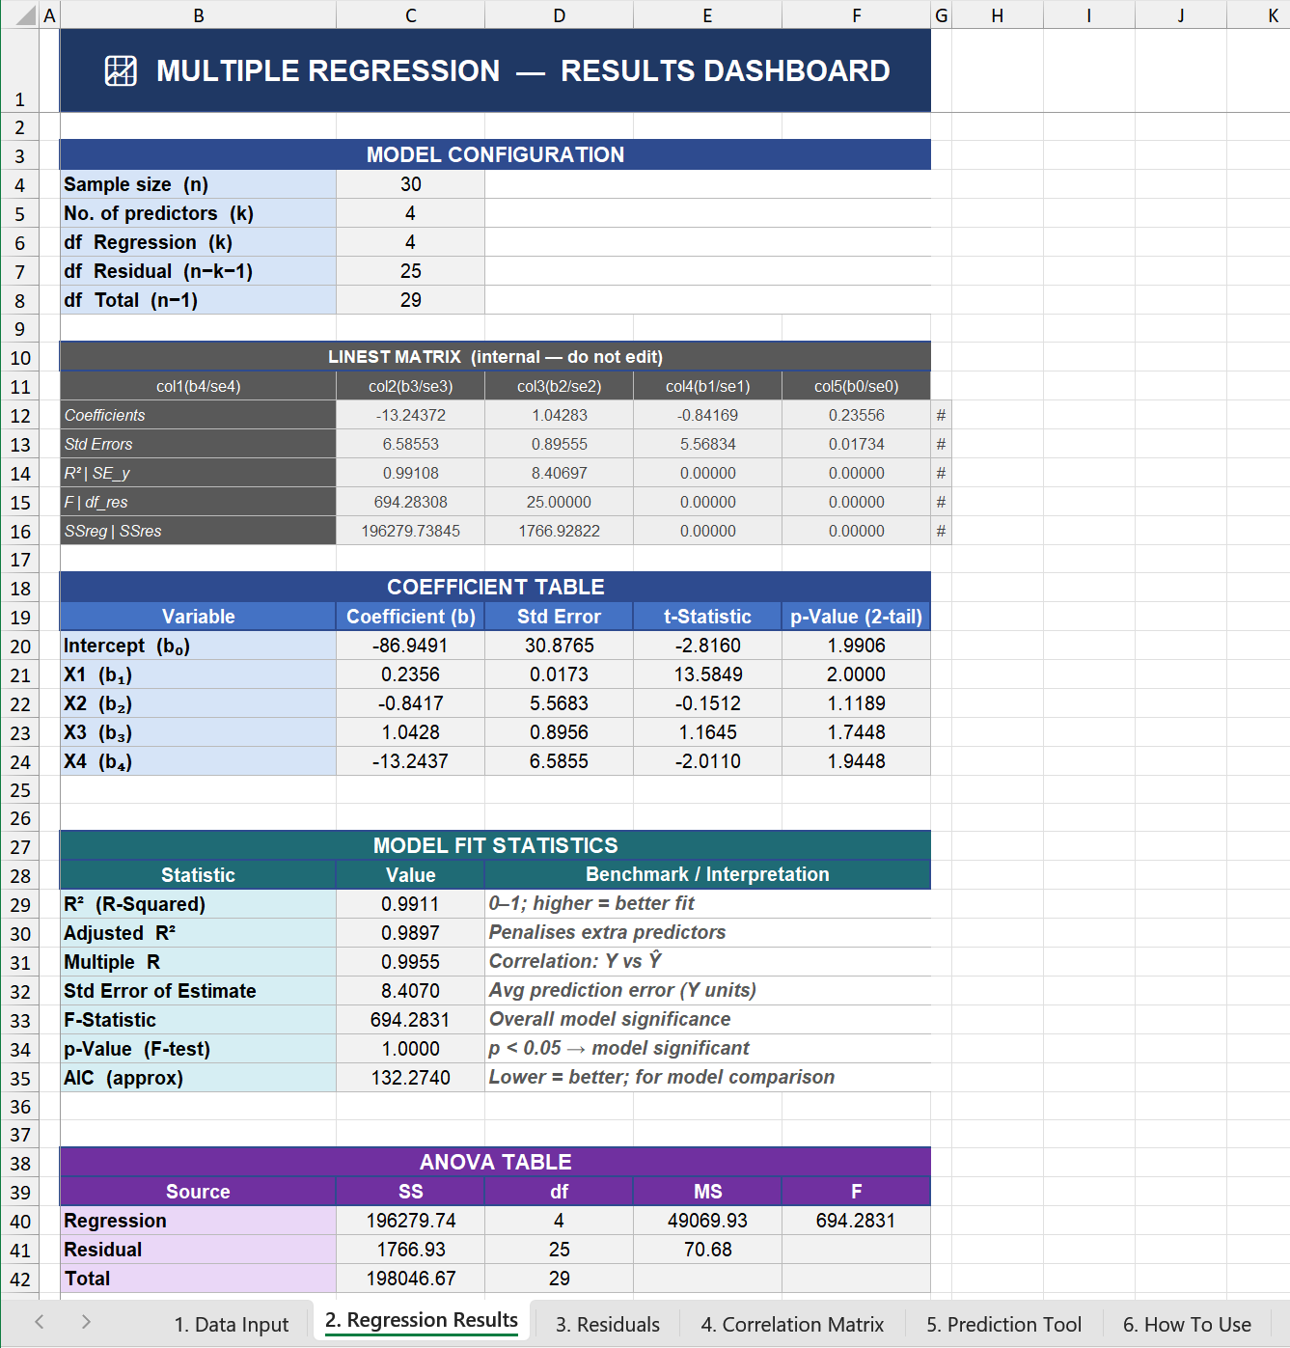
Claude

Slide 37
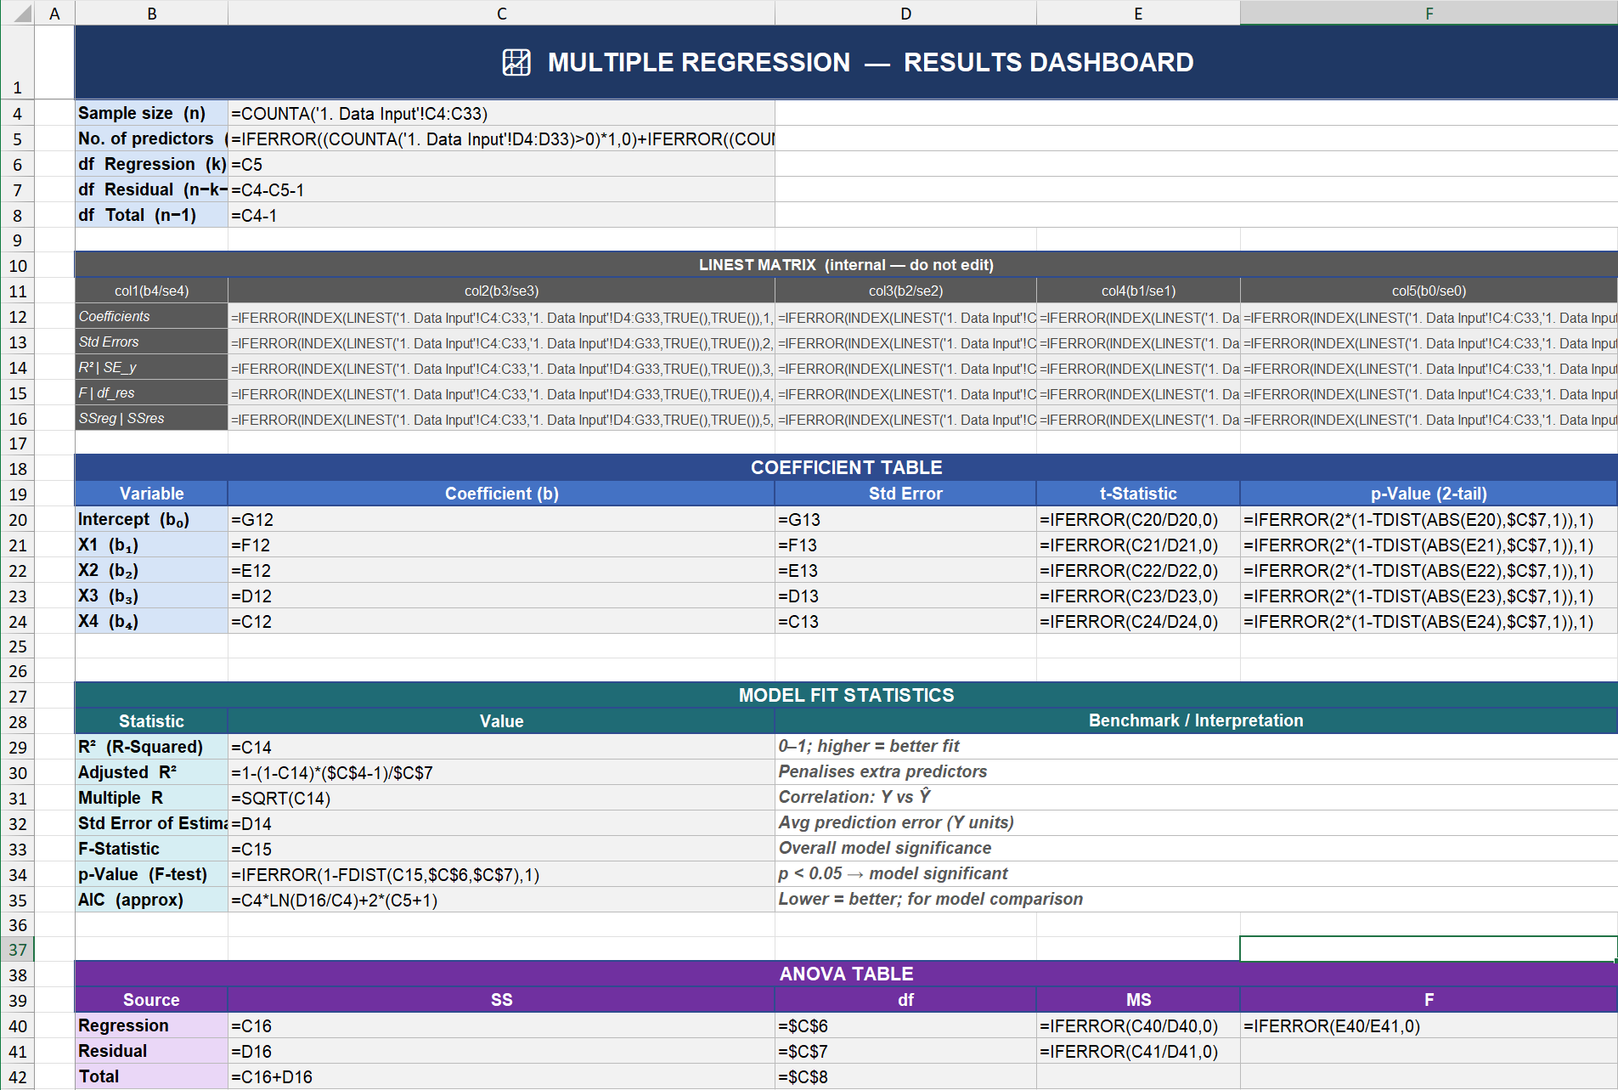
Claude

Slide 38
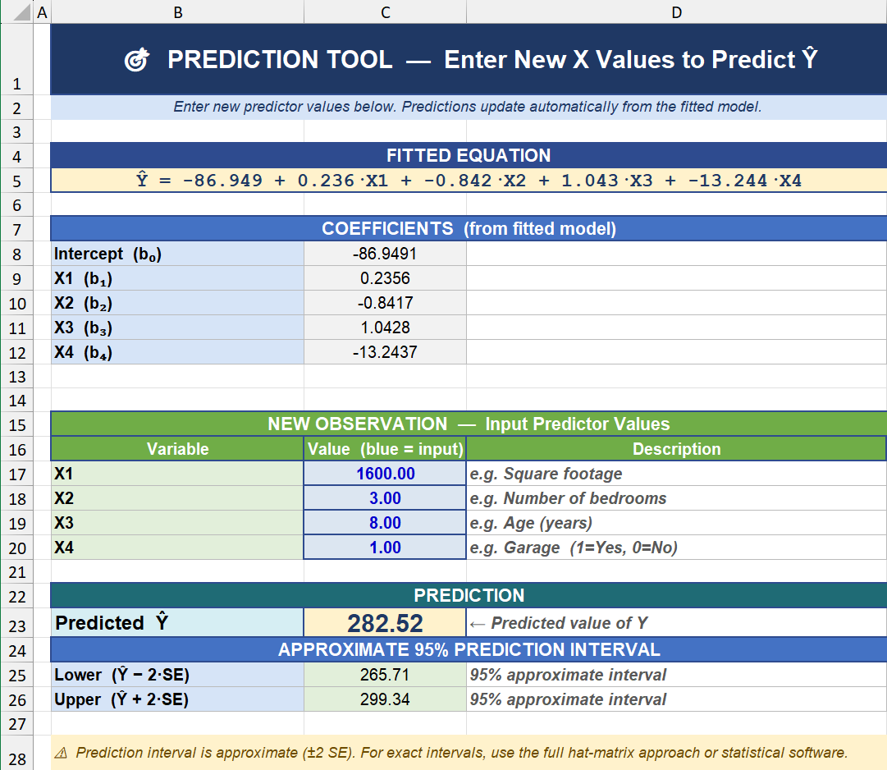
Claude

Slide 39
Instructional Designer’s Conclusion
15 Minutes with Claude
DID NOT
Undo 26 Years of Paid Work

Slide 40
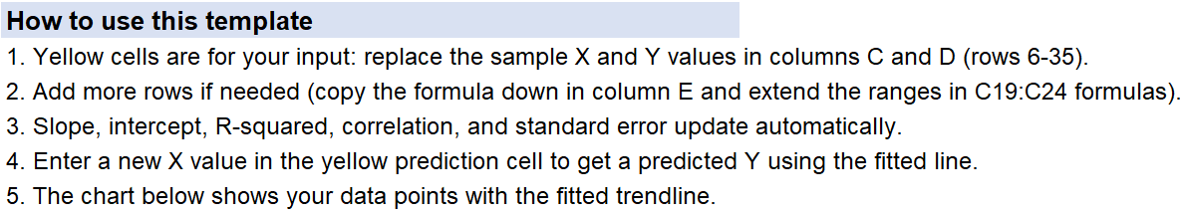
I Met Myself in Claude

Slide 41
Reflections

Slide 42
Walter Quattrociocchi (Sapienza University of Rome)
Experiments that tested human and LLM “reasoning”
Linguistic plausibility of model was taken as a “surrogate” of truth.
Danger: The simulation of knowledge becoming indistinguishable, to the learner, from knowledge itself.”

Slide 43
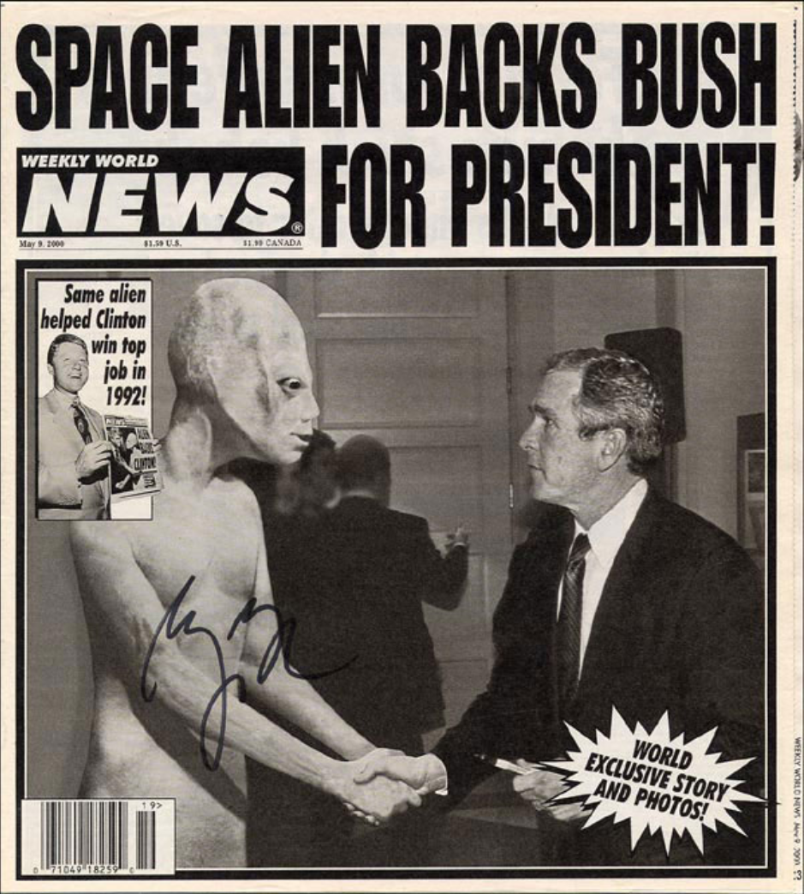
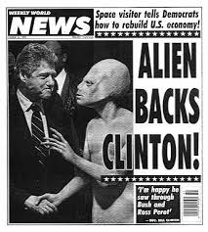
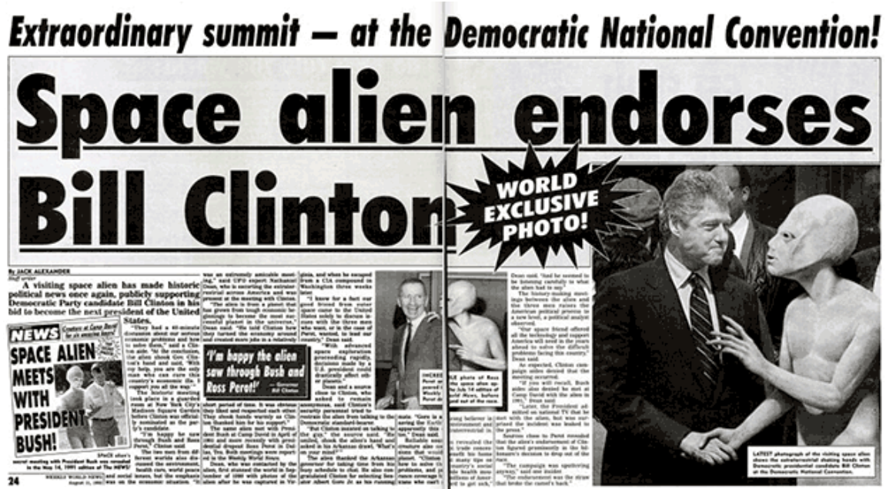
“An old issue”

Slide 44
Luntz: “It’s not what you say, it’s what people hear”
Credibility as important as point of view
Novelty—offer something new
Speak aspirationally
Ask a question
Provide context and explain relevance

Slide 45
Stephen Colbert’s “Truthiness”
Truthiness concept: perceiving something as true because it “feels true”

Slide 46
“Claude reigns over the usual Gen AI suspects for the moment.”
I asked Claude,
“Why is that statement humorous?”

Slide 47
Why is the statement humorous?
Riff on “the usual suspects.” Connotes criminality, refers to the classic idiom, & a famous film title
Humorously frames major AI companies as a rogues’ gallery of criminal characters
Claude “reigning” over this shady lineup

Slide 48
Why is the statement humorous?
“There's a slight self-congratulatory wink to it...”
“ for the moment adds a final dry touch — acknowledging that this criminal underworld is unstable and the rankings could shift...”

Slide 49
Why is the statement humorous?
“it's funny because it casts a mundane AI performance comparison as a noir crime drama, with a touch of self-awareness and humility at the end.”
Wrong!

Slide 50
How is a Claude agent like a character actor?
“It's a fun analogy! Here's how a Claude agent is like a character actor...”
The effect on affect of
positive or affirming statements?

Slide 51
Inspiration from Presentations at Prior DSI Conferences
Cheryl Hild’s “Teaching Beyond the Myths: Helping Students Critically Evaluate AI in Analytical Decision‑Making” at the 2026 DSI Pedagogy Conference

Slide 52
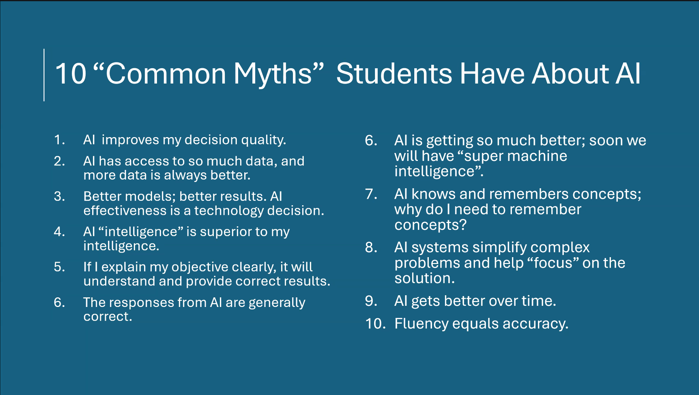
Reference pedagogy conference here

Slide 53
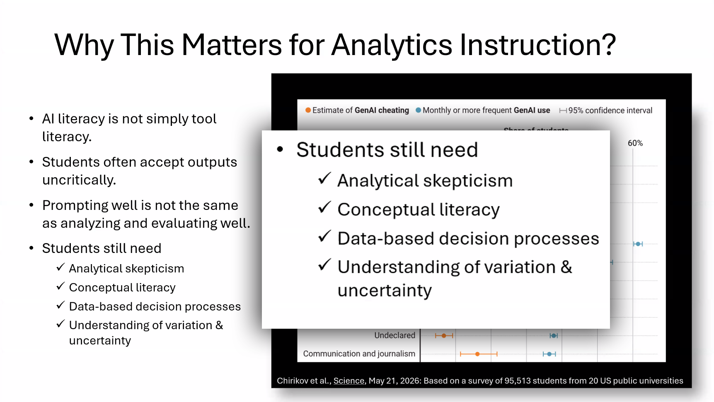
✓ Understanding AI “truthiness”

Slide 54
Do learners fully understand…?
From a November 2024 presentation
  Confusion about concepts important to fact-based decision making
    belief versus fact
    lack of skepticism
    overlooking quality of evidence
Taught well*, hypothesis testing clarifies confusion.
* Note the disclaimer!

Slide 55
Implications

Slide 56
Rounding Up The Usual Suspects
Interpretation of results
Communication of results
Development of critical thinking skills

Slide 57
Critical Thinking
Why did some understand the satire of the alien endorsing Bill Clinton while others did not?
Why is Claude so wrong about humor?

Slide 58
Critical Thinking
Why did some understand the satire of the alien endorsing Bill Clinton while others did not?
Why is Claude so wrong about humor?

Slide 59
Evaluating Gen AI Results
Duplication of results is not critical thinking.
What’s the critical thinking skill here? Or Is it all about applying a set of rules?
What constitutes expertise when dealing with Gen AI?

Slide 60
A New Approach to “Data Analysis”
Always has been presented as:
“A better way for fact-based decision making”
Might this be a better framing:
“A proper way of making fact-based decisions
Should course work be designed differently?

Slide 61
Confession Time

Slide 62
For those looking for movie puns…
Claude Atlas — Cloud Atlas
Claudy with a Chance of Meatballs — Cloudy with a Chance of Meatballs
Claude of Duty — Call of Duty
Claude of the Wild — Call of the Wild
Claude Encounters of the Third Kind — Close Encounters of the Third Kind

Slide 63
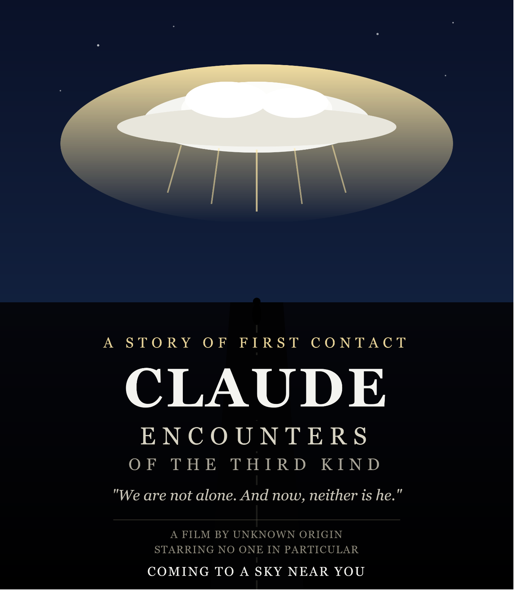


Slide 64
Thank you!
  Email: david@twobridgesit.com
  See you in San Francisco this November?!
  “It’s still a story without an ending.”
  Download this presentation at https://bit.ly/TBITDownloads
  (case sensitive URL)

