Slide 1
The following presentation
Asks questions
Provides no answers
Looks for your feedback
And contains no humor, except….

Slide 2
Why did the chicken…

Slide 3
Humor, Humor
…cross halfway across the road?
Why didn’t the chicken cross the road?
Why is everyone mad when the pig crosses the road?
Why did the turtle cross the road?

Slide 4
Repetition: Positives
Activates recall
Reuses what worked previously
Repetition: Negatives
Cannot reflect or address change
Promotes staleness, lowers cognition
z

Slide 5
Instructional Designer Keeps Hearing…
Foster “critical thinking”
Emphasize management decision-making
Consider how Gen AI effects things

Slide 6
No More Cowpaths For Me
Presented by David Stephan
David@TwoBridgesIT.com
Saturday, November 22, 2025, 1 PM Eastern
bit.ly/TBITDownloads

Slide 7
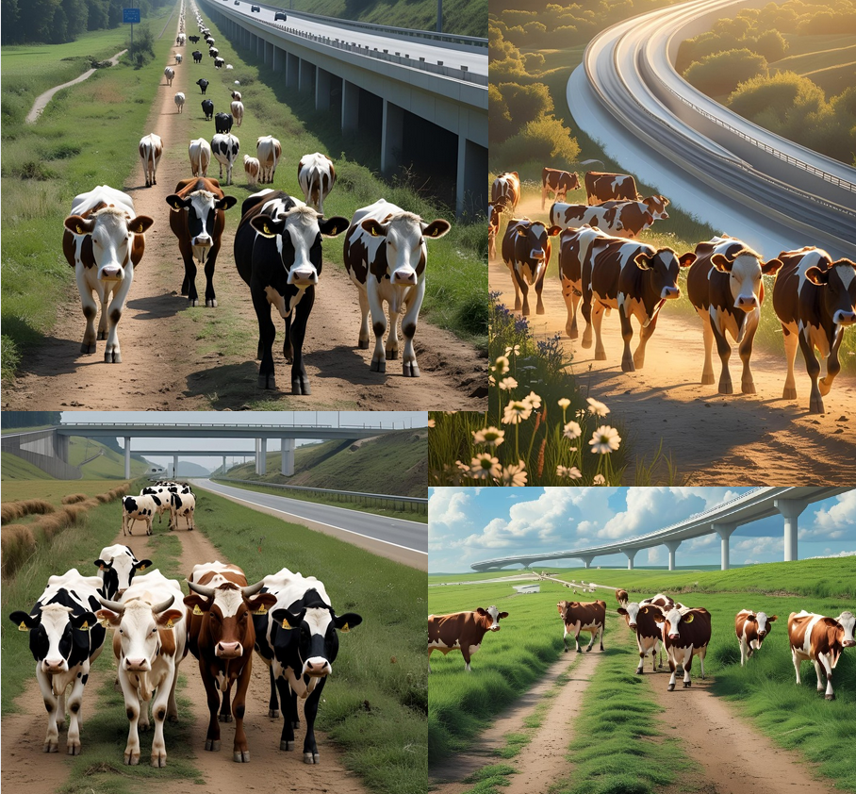
100% Genuine
Gen AI Images

Slide 8
Cowpath Metaphor
It is time to stop paving the cow paths. Instead of embedding outdated processes in silicon and software, we should obliterate them and start over.
Michael Martin Hammer
You can keep repaving the same old cowpath or build a new highway.
paraphrase of David Kroenke

Slide 9
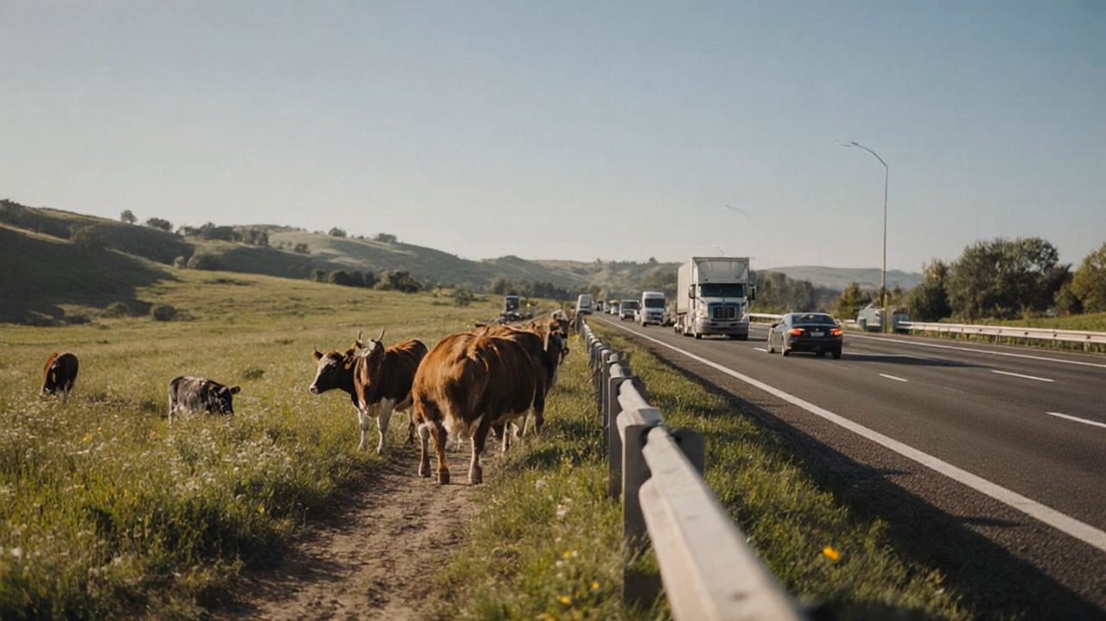
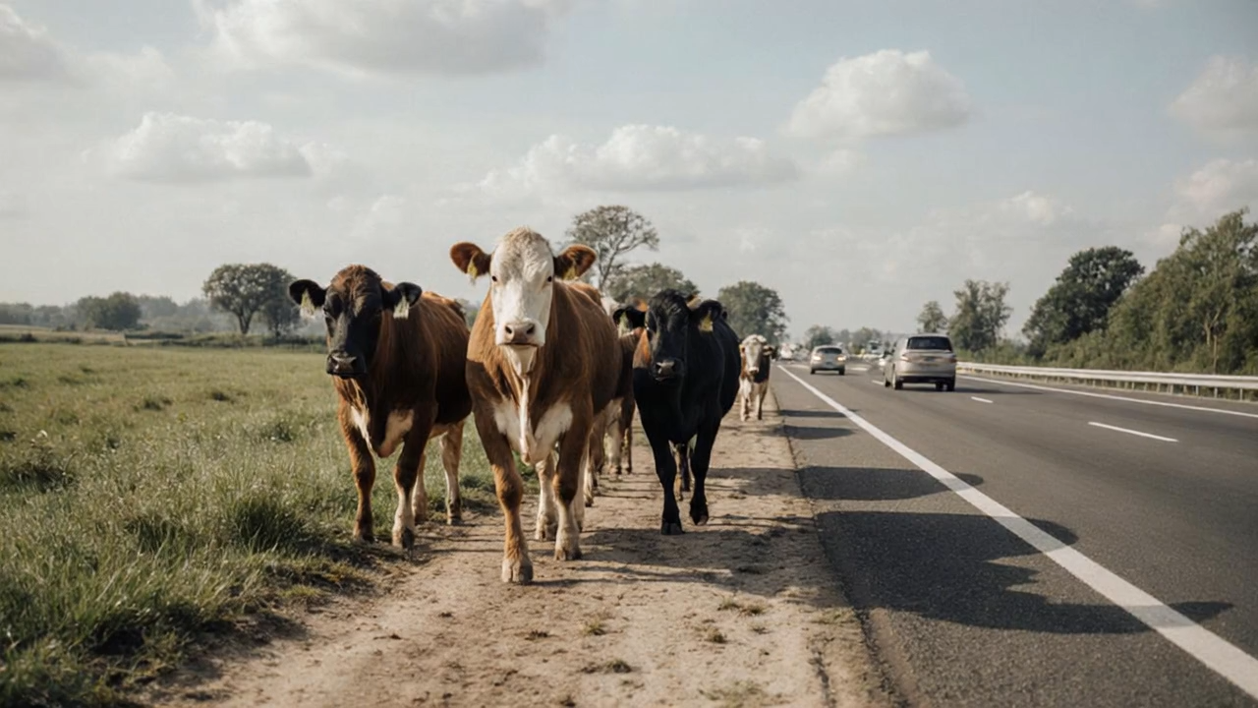
Cowpaths
Gone Wrong
Gen AI videos

Slide 10
Starting Point
Why Do We Teach
What We Teach
in the Order
That We Teach It?

Slide 11
Methodology
Examine business statistics textbooks from late 1940s
Look at long-running textbook series
Consider metaphorical inflection points
Cut-off date: late 1980s

Slide 12
Trace Three Author Series
John Stockton (1947 through 1985), Introduction to Business (& Economic) Statistics
Neter & Wasserman (1956 through 1969), Fundamental Statistics for Business and Economics
Freund & Williams (1958 through 1988), Elementary Business Statistics, Modern Business Statistics
Sources: archive.org, used book sellers

Slide 13
Seeking
Why Do These Books
Teach What They
Teach In the Order
That They Teach It?

Slide 14
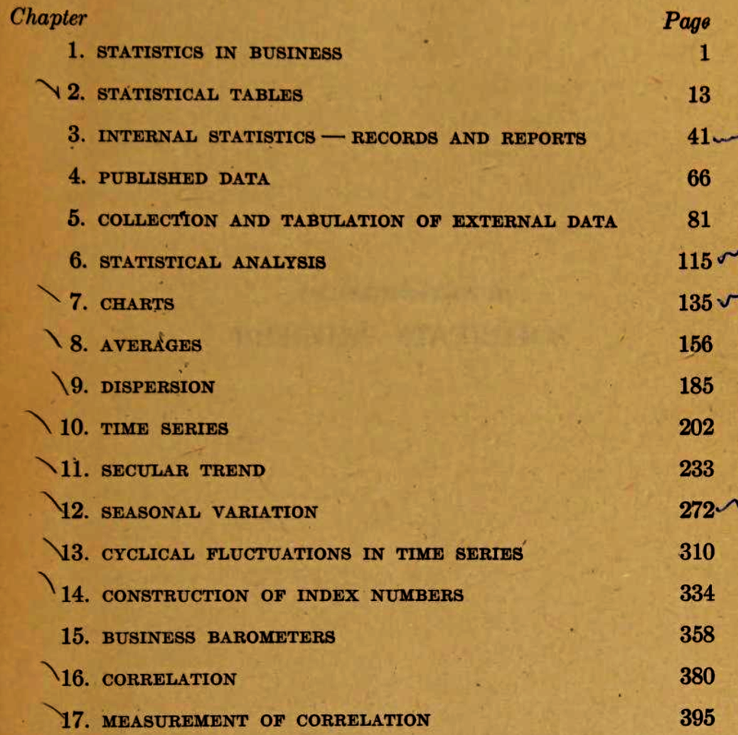
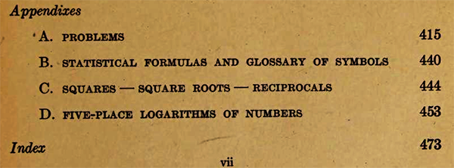
Stockton 2/e, 1947
charts, averages, dispersion, time series,
index numbers, correlation, (regression)

Slide 15
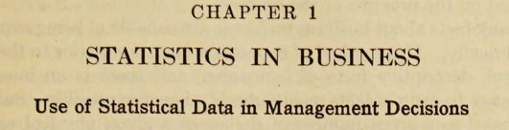
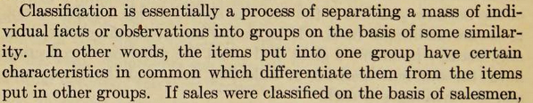
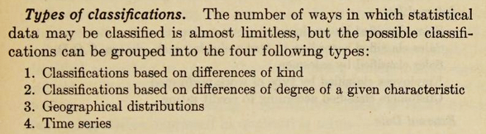
Sounds current
until it doesn’t

Slide 16
Stockton 2/e, 1947
Pre-modern
“internal statistics”
“tabulation”

Slide 17
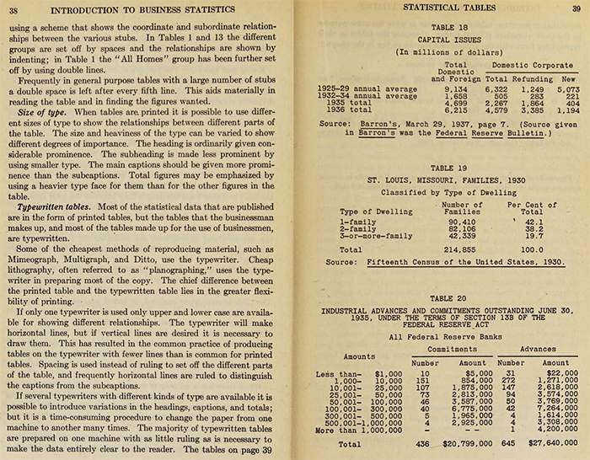
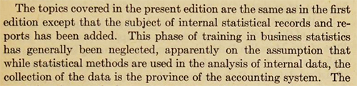




Does not sound current!

Slide 18
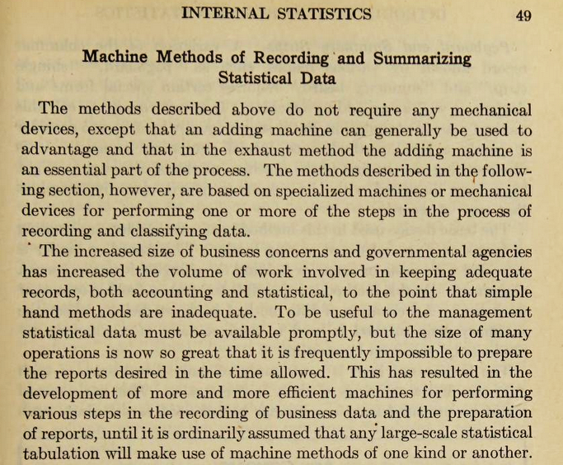
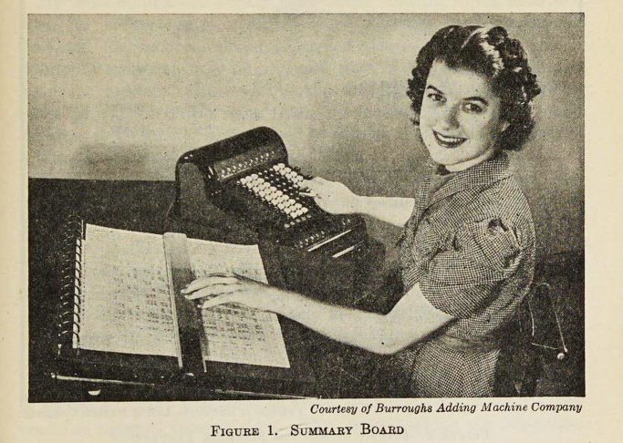

Does not even look current!

Slide 19
Stockton 2/e, 1947
Statistics link to financial accounting
Familiar terms with unfamiliar meanings
Describing data technology a mistake?

Slide 20
Transition to
“Modern” Statistics

Slide 21
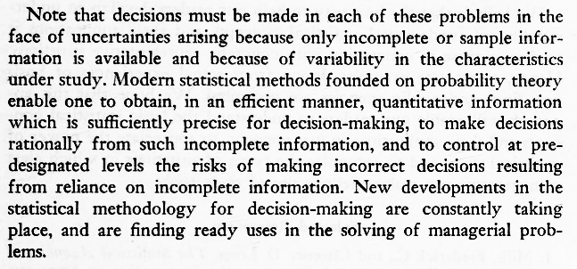


From Chapter 1 (Neter & Wasserman, 1/e, 1956)

Slide 22
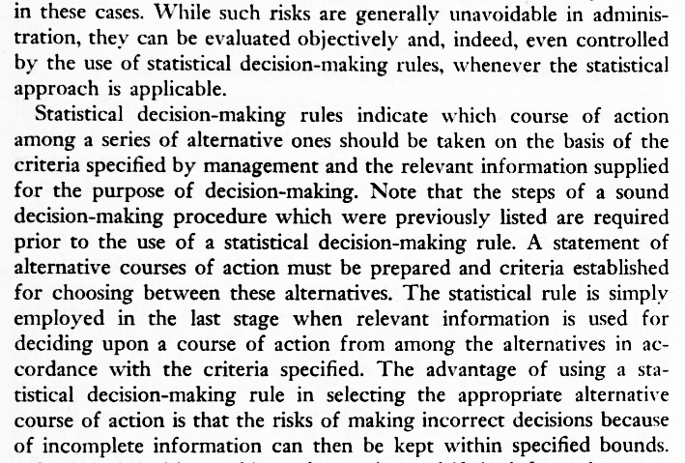

From Chapter 10 (Neter & Wasserman, 1/e, 1956)

Slide 23
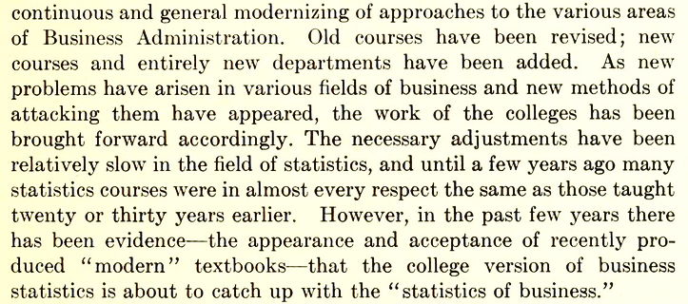
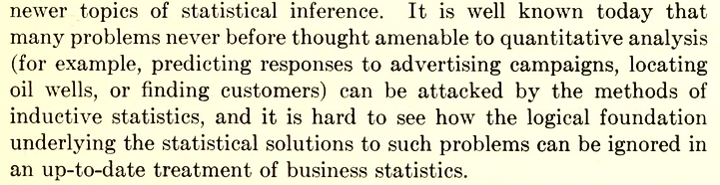





“Modern” statistics (Freund & Williams, 1/e, 1958)

Slide 24
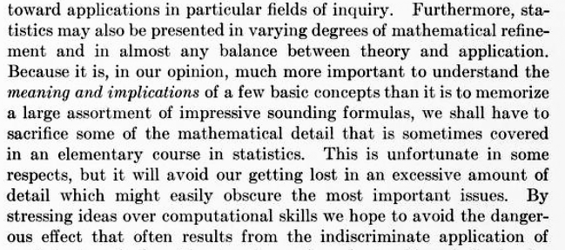



From Introduction (Freund & Williams, 1/e, 1958)

Slide 25
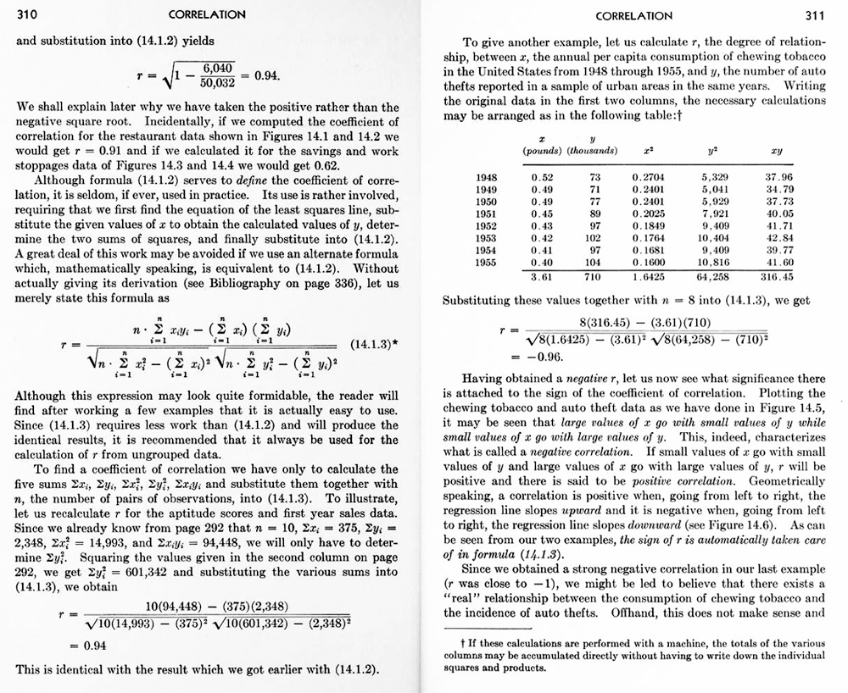
F&W 1/e, 1958
F&W 1/e, 1958
Is this sacrificing
mathematical
detail?

Slide 26
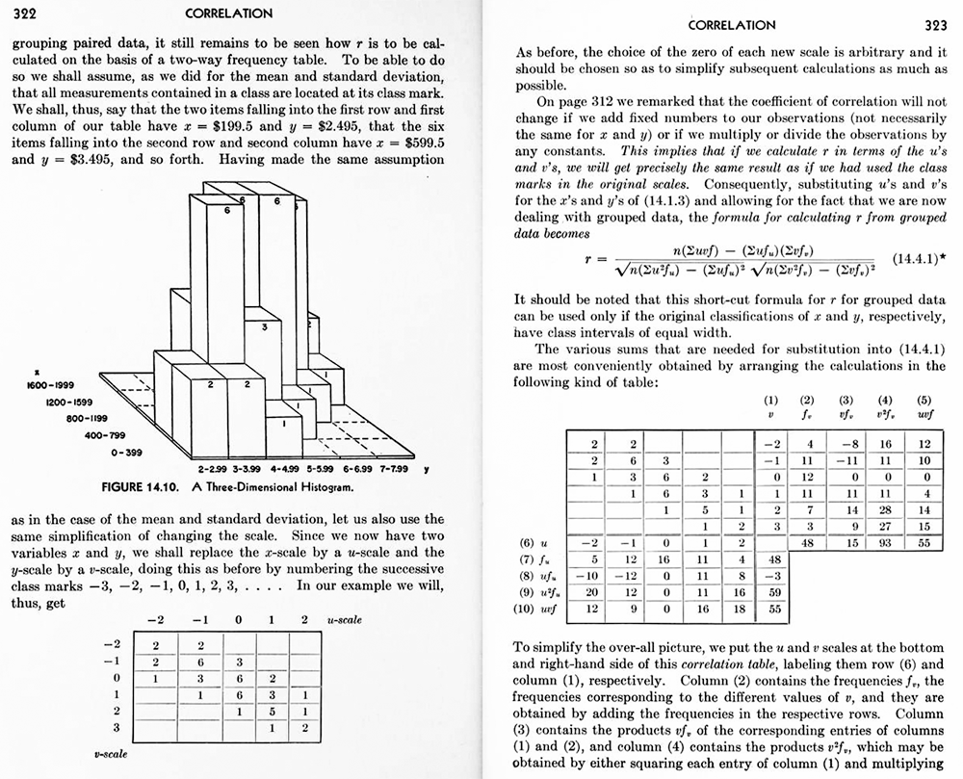
F&W 1/e, 1958
Is this sacrificing
mathematical
detail?

Slide 27
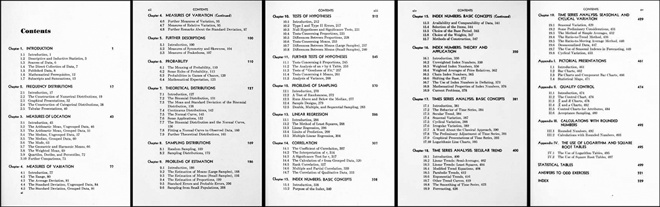
F&W 1/e, 1958 TOC

Slide 28
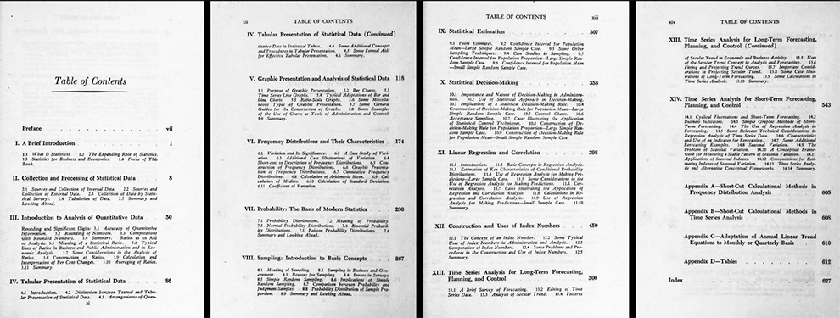
N&W 1/e, 1956 TOC

Slide 29
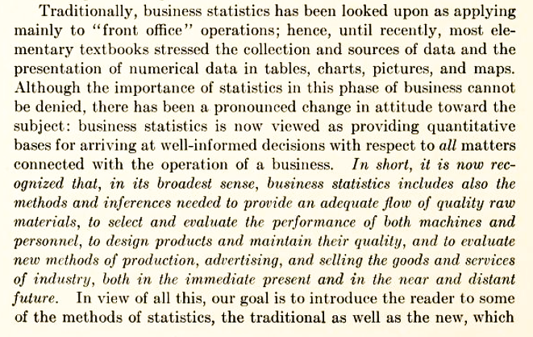
For Chapter 1 (Freund & Williams, 2/e, 1969)

Slide 30
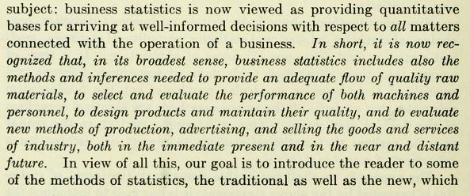


“Modern” statistics (Freund & Williams, 2/e, 1969)

Slide 31
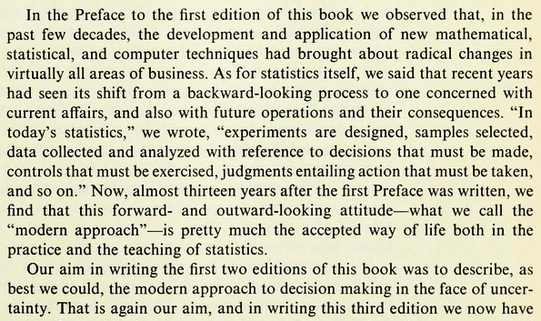




Modern statistics (Freund & Williams, 3/e*, 1977)

Slide 32
F&W 1/e, 1958 TOC (19 chapters)

Slide 33
Transition to “End-User”
Statistics Software

Slide 34
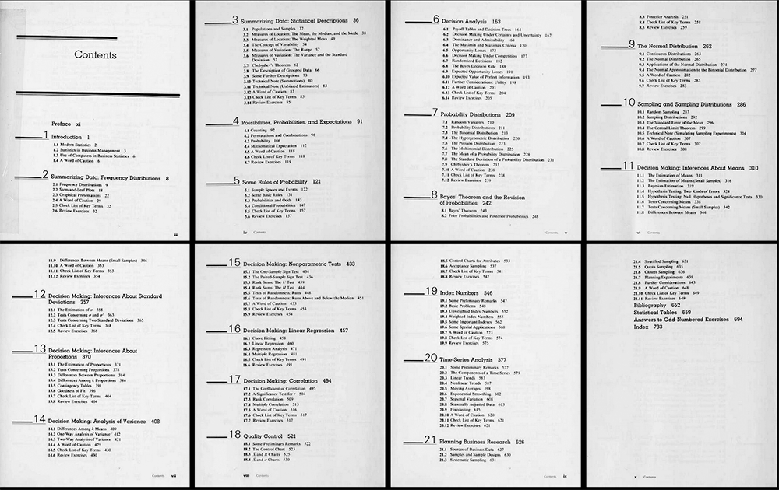
F&W 5/e, 1988 TOC
(21 chapters)

Slide 35
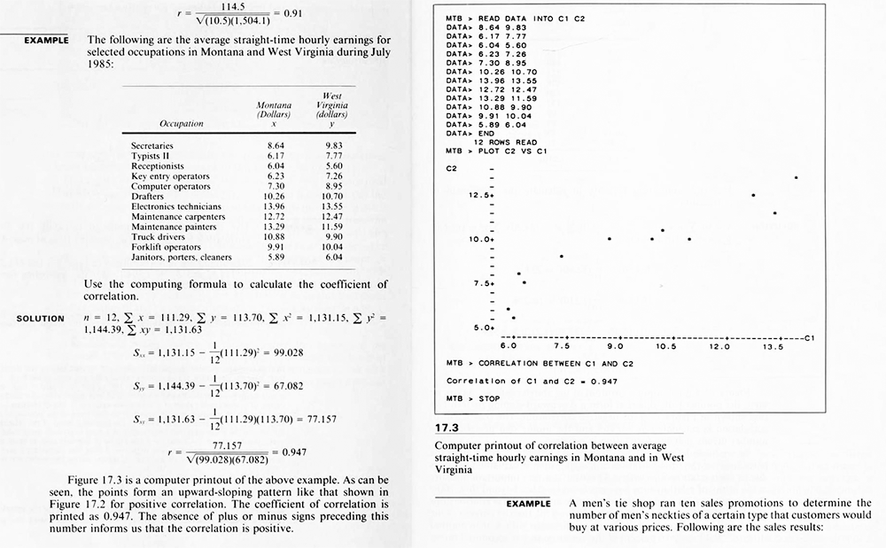
F&W 5/e, 1988

Slide 36
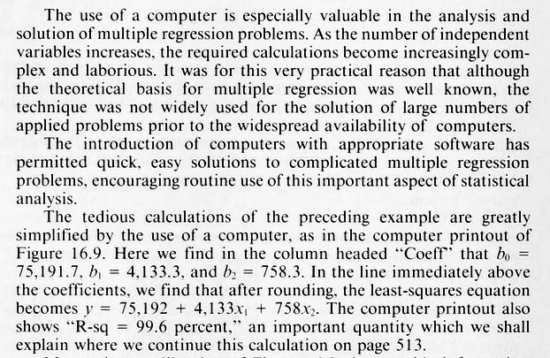
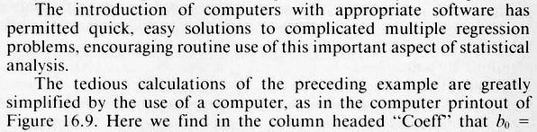
F&W 5/e, 1988

Slide 37
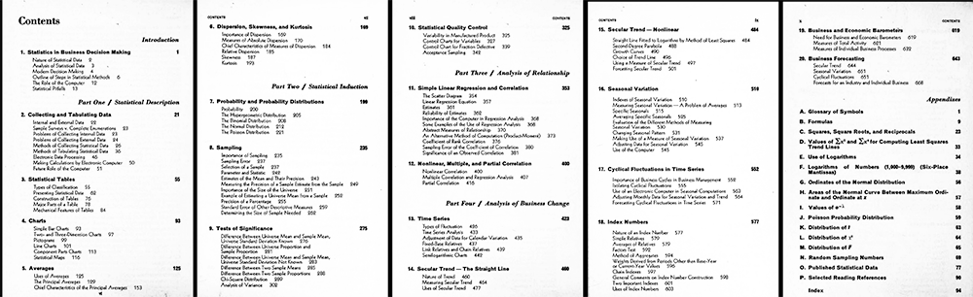
Stockton 4/e, 1971

Slide 38
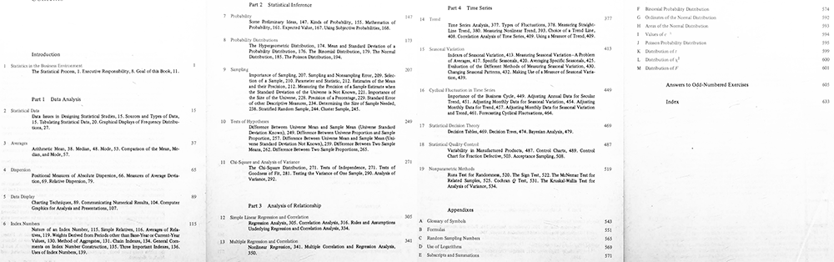
(Stockton) Clark & Jordan 7/e, 1985

Slide 39
Conceptual Issues
Making mgrs. capable of calculations vs.
making mgrs. aware of statistics
“Statistical decision-making” mostly emphasized non-critical use of results
Exclusively pre hoc, lack of ex post or post hoc
Numerical data “bias”

Slide 40
Designer’s Observation
The antecedent to nearly every complaint/concern about statistics learning DASI SIG has discussed can be traced to the choices made by those pioneering 1950s authors.

Slide 41
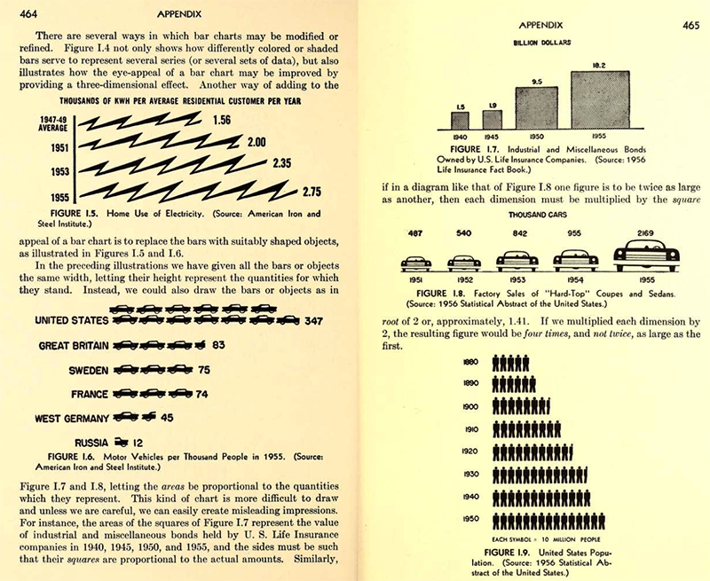
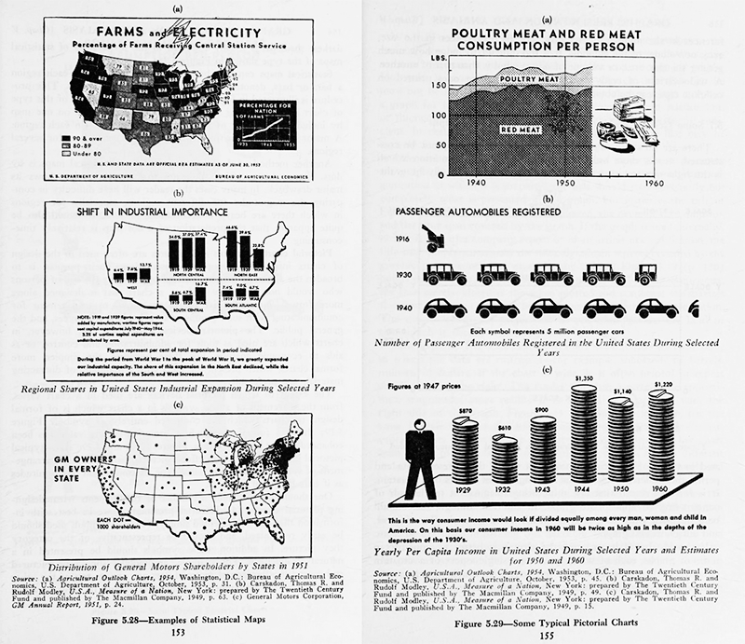
Simple Example

Slide 42
Why Do These Books Teach What They Teach In the Order That They Teach It?
Answer: They are repaving cowpaths

Slide 43
Things Observed
“Data chapter” changes the most
Some topics move around but do not change
New topics tacked on to TOC without regard to prior topics
Some new topics appear, then disappear

Slide 44
Question
Does my reasoning
make sense to you?

Slide 45
Repaving Cowpath Didn’t Work
Modified chapter-framing cases to add more business context
Ended up with “post-game” commentaries in EOC summary sections

Slide 46
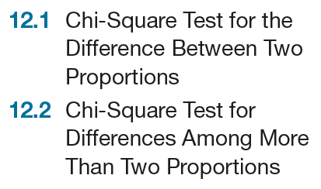
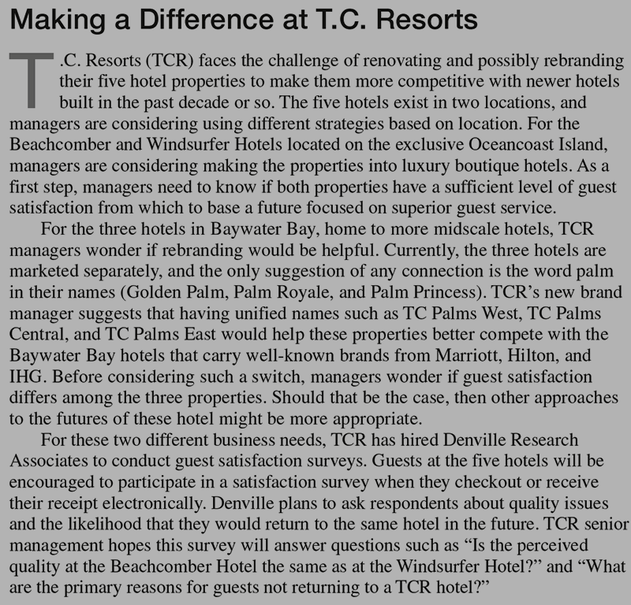
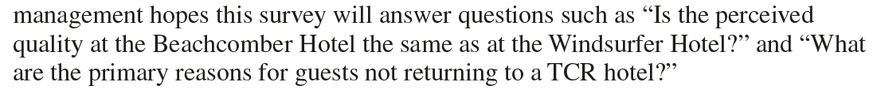
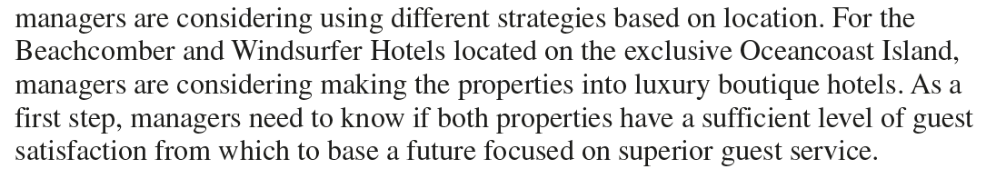
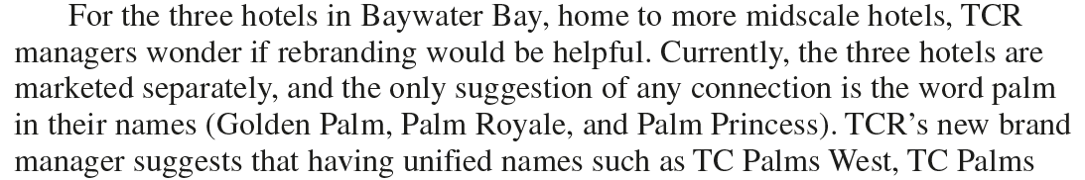





Slide 47
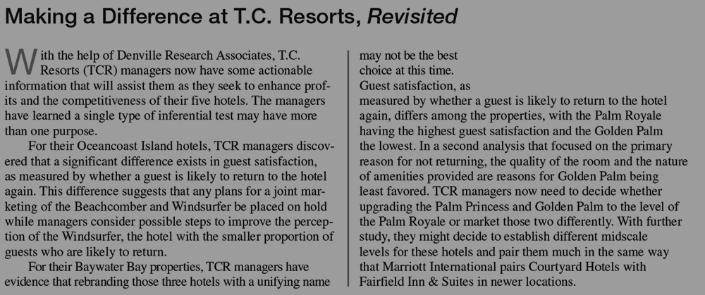

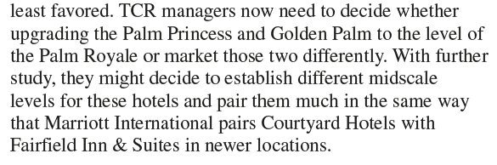



Forced into “Post-Game Analysis”

Slide 48
As I was saying…
No More Cowpaths For Me

Slide 49
Things to Avoid
Adding/subtracting topics with little regard for effect on other sections
Focusing on (mechanical) problem solving instead of decision making

Slide 50
Things to Achieve
Focus on management decision, not statistical result
Examine methods in context of a management decision
Rely on computerization
Avoid “post-game” analyses

Slide 51
Remembering that
Storytelling is Not Just for Data

Slide 52
Need to Use a Narrative Frame
Construct
multiple layers (“extended problems”)
multiple acceptable “courses of action”
capability to use Gen AI constructively
a new highway, not a repaved cowpath
something that integrates multiple media

Slide 53
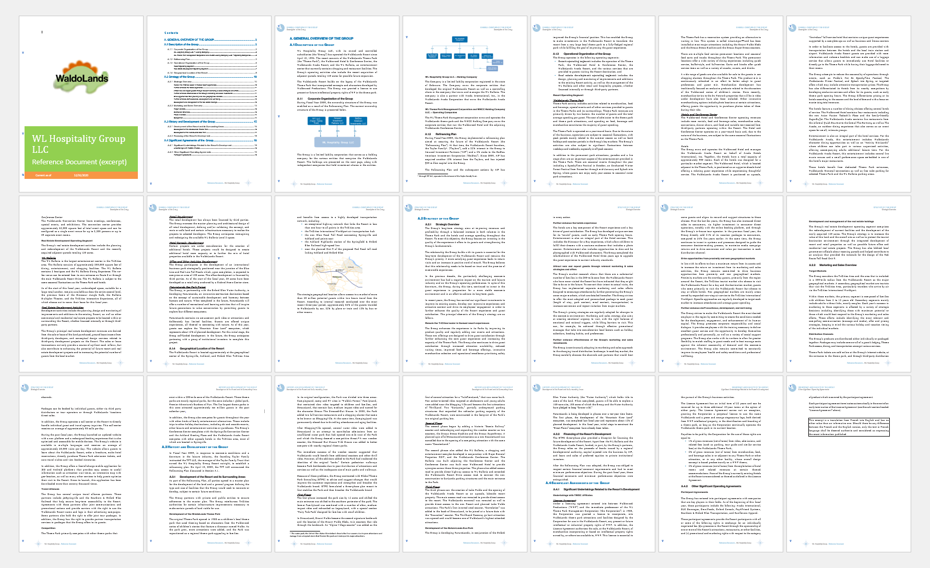

Slide 54
Leap of Thinking…
Open mystery concept (the “new highway”)
Uses branching network design
Does not repave the cowpath of topic organization based on historical incremental change

Slide 55
How It Would Work
Detailed open mystery presented as a “mockumentary”
Managers explain their application of data analysis techniques
Learners evaluate management choices, not “statistical data”

Slide 56
Question
Is That Idea
Worth Pursing?

Slide 57
Coming This November Next Year?
Using a complex business case to support a new approach for teaching introductory courses
Thank you! Comments solicited!
david@twobridgesit.com
Download this presentation at https://bit.ly/TBITDownloads
(case sensitive URL)

Slide 58
THE END

Slide 59
Selected slides from a previous DASI SIG “brown bag” session follow this slide.

Slide 60
Branching Networks Characteristics
Useful for
asides and digressions
instructions that have multiple possible outcomes
problems that lead to multiple possible outcomes
increasing affect: grant learners some agency*
*Agency is the reason that open-world environments are popular online amusements.

Slide 61
Examples of “degenerate case”
The previous interactive learning experience
Previous/Next buttons: “simple interactivity”
This PowerPoint slide deck/This live stream
Limitations of PowerPoint (or similar software)

Slide 62
Tools for Branching Networks
Many choices including pencil and paper
Rejected H5P
Settle on interactive fiction tools
Minimizes time to create a branching network
Requires minimal training
Provides for universal display and easy distribution
Chose Twine

Slide 63
Twine
Open source actively maintained, simple to install
Accommodates several levels of user experience (SugarCube)
Wide user base, active community
Well-supported by examples and Q&A websites
Gen AI (ChatGPT) makes using Twine even simpler

Slide 64
The Gen AI Part (uses ChatGPT free version)
ChatGPT creates the Twine markup code* for your branching network
*Markup code not hard to learn.

Slide 65
The HOW Part 1 of 2
Develop content (the hard part!)
Prompt ChatGPT with a plain English description of the branching network needed
Save ChatGPT response as a text file with the file extension .twee (not .txt)

Slide 66
The HOW Part 2 of 2
Open Twine
Import .twee file (Library ➔ Import)
View “story map” visualization
Click a node, edit node name and type or paste content
Publish as a HTML file (Build ➔ Publish to File)

